Slide 1


COS30018 Intelligent Systems
Semester 1, 2024
Reshaping the Retail Industry using AI vision
Syed Muhammad Hassan Bin Ghayas (101231186)
Tan Chai Ching (104386076)
Chong Chao Sen (102762412)
Lau Lik Yang (104384818)

Slide 2

Content
Introduction
Overall system architecture
Data Collection & Annotation
Implemented machine learning techniques
Critical Analysis of the Implementation
Practical Application Description
Conclusion

Slide 3
Introduction
Introduction
AI and computer vision in retail to boost productivity and customer satisfaction.
Project uses AI for stock monitoring and product organization.
Problem Statement
Traditional methods prone to errors, leading to lost sales and customer dissatisfaction.
Aim
Develop AI technologies for automated stock monitoring and product layout.
Increase operational efficiency and improve customer experience.
Approach
Evaluate three AI models for real-time detection in dynamic retail environments.
Assess ability to identify out-of-stock conditions and maintain store layout.

Slide 4



Overall system architecture
Solution Overview
Improve retail operations by identifying missing products and arranging merchandise.
Uses pipeline_file.config for consistent and easy maintenance of model settings and parameters.
Models
SSD MobileNet V2 FPNLite-320
SSD MobileNet V2 FPNLite-640
SSD MobileNet V2
Fast and accurate, suitable for quick scans.
Performs well in varied lighting, ensuring compliance with layout plans.
Offers high-resolution detection for densely packed shelves.

Slide 5
Overall system architecture
Data Integration and Workflow
Utilizes Google Colab for model training with extensive datasets.
Images from COCO dataset and specific retail settings used for training, validation, and testing.
Trained models applied in real-time through GUI, using live video feeds to showcase effectiveness in retail environments.
Technology and Infrastructure
Utilizes TensorFlow for data processing and object detection in real-time.

Slide 6
Data Collection & Annotation
Dataset Classes:
'Empty': Identifies out-of-stock areas.
'Misalignment': Detects non-compliant shelf arrangements.
Image Count:
Initially larger dataset faced issues; refined to 200 annotated images.
Training Images: 160 per class.
Validation Images: 20 per class.
Testing Images: 10 per class reserved for final evaluation.
Annotation Process:
Images annotated in XML format for compatibility with TensorFlow's Object Detection API.
Class labels: 'Empty' (0), 'Misalignment' (1).
Bounding boxes mark specific areas in images.
Image Acquisition:
Diverse conditions: various environmental settings, viewpoints, and lighting scenarios to enhance dataset diversity.

Slide 7
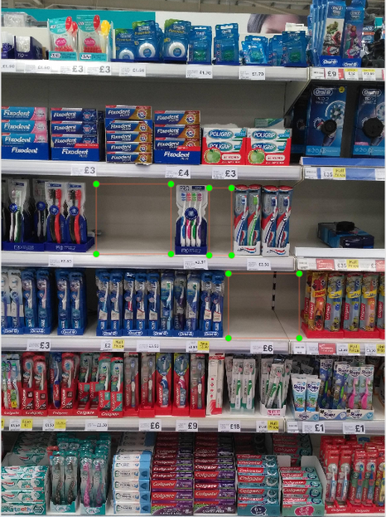

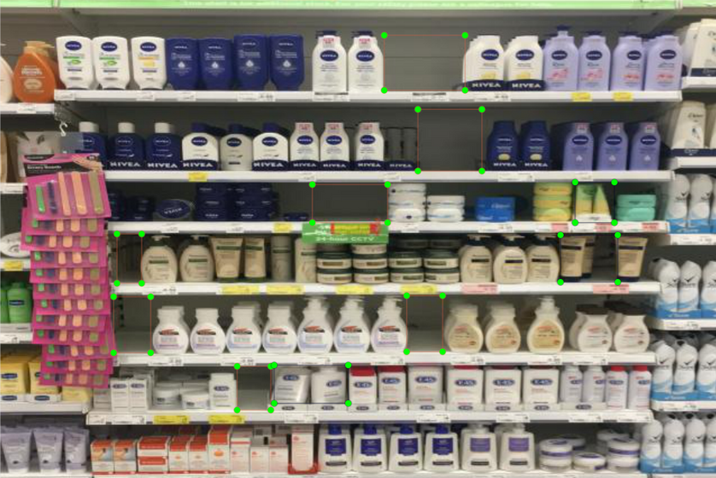
Data Collection & Annotation
Annotation Process
Used labellmg to manually annotate images.
Bounding boxes drawn for 'Empty' , 'Misalignment' and both ‘Empty and Misalignment’ scenarios.
Precise annotations for accurate model training.

Slide 8

Implemented machine learning techniques
MODEL CONFIGURATION
SSD MobileNet V2
SSD MobileNet V2 FPNLite-320:
SSD MobileNet V2 FPNLite-640
Single Shot MultiBox Detector Module
Offers high resolution for accurate detection in densely packed shelves.
Efficient and effective for quick scans of retail shelves.
Enhances detection under varied lighting conditions.
Performs object localization and classification in a single pass.
Notes:
Our project uses advanced AI models to improve retail operations by monitoring stock levels and product alignment. We employed three models: SSD MobileNet V2 for quick scans and out-of-stock detection, SSD MobileNet V2 FPNLite-320 for varied lighting conditions, and SSD MobileNet V2 FPNLite-640 for high-resolution detection in densely packed shelves

Slide 9
Implemented machine learning techniques
Training Process
Used pre-trained weights from COCO dataset.
Modified weights for retail settings.
Used data augmentation techniques like batch normalization and horizontal flipping.
Training carried out on Google's TPU-8.
Model Evaluation
Evaluated performance based on precision, recall, and COCO detection measures.
Notes:
We used pre-trained weights from the COCO dataset and modified them for our retail settings, employing data augmentation techniques such as batch normalization and horizontal flipping

Slide 10
Implemented machine learning techniques
Label Map Creation
Created label map file for model interpretation.
Classes: 'Empty' (0) for out-of-stock areas, 'Misalignment' (1) for misalignment non-compliance.
Checkpoint and Fine-Tuning
Initialized training using a checkpoint from a pre-trained model.
Used transfer learning to fine-tune the model to the specific dataset
Notes:
We trained our models using pre-trained weights from the COCO dataset, adapting them for our specific retail settings.

Slide 11
Implemented machine learning techniques
File Paths and Readers
Specified file paths for training and validation data.
Used TensorFlow's tf_record_input_reader for reading TFRecord files containing annotated images.
Class Parameters
Configured parameters for class prediction bias initialization, number of classes, weighted sigmoid focal loss, localization loss, learning rate, optimizer, number of steps, and batch size.
Notes:
"We evaluated the performance of our models based on precision, recall, and COCO detection measures to ensure their effectiveness in a retail environment

Slide 12
Implemented machine learning techniques
Model Evaluation
Evaluated performance based on precision, recall, and COCO detection measures.
Label Map Creation
Created label map file for model interpretation.
Classes: 'Empty' (0) for out-of-stock areas, 'Misalignment' (1) for misalignment non-compliance.
Notes:
We created a label map file for model interpretation with classes 'Empty' for out-of-stock areas and 'Misalignment' for misalignment non-compliance. We also used transfer learning to fine-tune the models to our specific dataset.

Slide 13
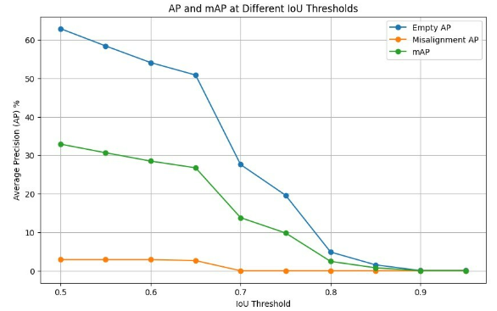
Critical Analysis of the Implementation
mAP Graph for
Multi-Class
(SSD MobileNet V2 FPN-640 )
Notes:
The mAP graph for multi-class detection using the SSD MobileNet V2 FPNLite-640 model showed robust performance in handling multiple classes simultaneously.

Slide 14
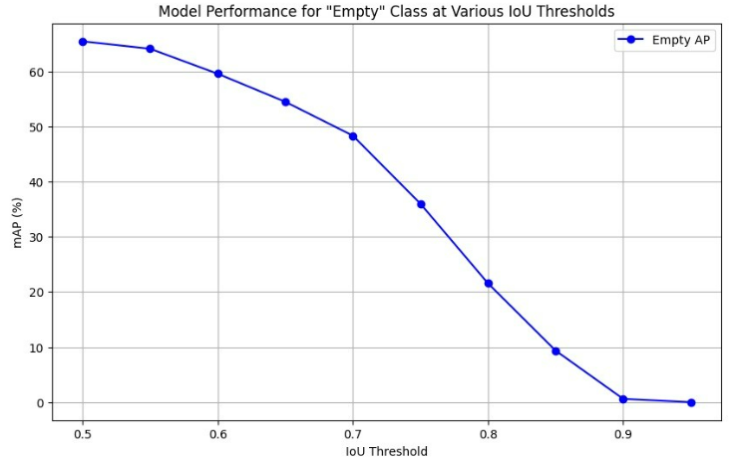
Critical Analysis of the Implementation
mAP Graph for
Empty Class
(SSD MobileNet V2 FPN-640)
Notes:
The mAP graph for empty shelves detection indicated that the SSD MobileNet V2 FPNLite-640 outperformed other models with a high mAP of 35.93%.

Slide 15
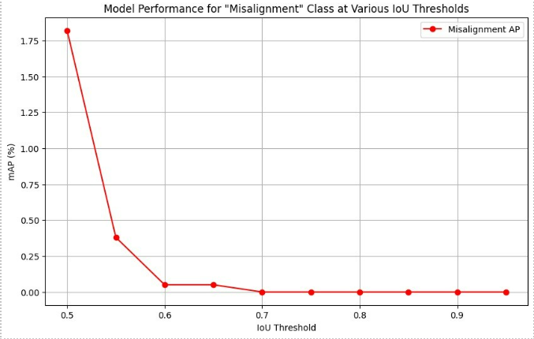
Critical Analysis of the Implementation
mAP Graph for
Misalignment Class
(SSD MobileNet V2 FPN-640)
Notes:
The mAP graph for misalignment detection revealed that the SSD MobileNet V2 FPNLite-640 had the lowest performance with an mAP of 0.23%, highlighting the challenges in detecting misaligned products."optimization.

Slide 16
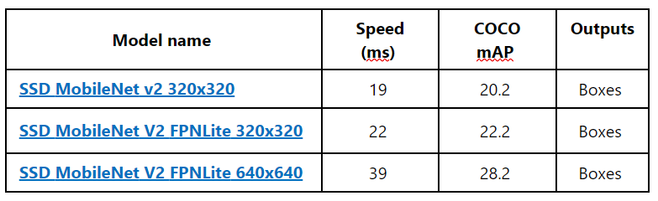
Analysis Summary
Performance for ssd-mobilenet-v2-fpnlite-640 models is better than the ssd-mobilenet-v2-fpnlite-320 and ssd-mobilenet-v2
The FPN-640 Multi-Class Model offers a balanced solution with good overall accuracy.
Notes:
While the SSD MobileNet V2 FPNLite-640 model showed promising results for empty shelf detection, the misalignment detection needs further optimization. Our analysis underscores the importance of model-specific training for targeted retail tasks.

Slide 17
Practical Application Description
AI-driven prototype for real-time use in retail environments.
Focuses on out-of-stock detection and misalignment compliance.
Uses strategically placed cameras and SSD MobileNet V2 FPNLite-640 model.
Triggers alerts for restocking and product rearrangement.
Enhances product visibility, maintains stock levels, and ensures attractive displays.
Notes:
Thank you, Hassan. Now, I’m going to talk about practical application description. The system employs strategically placed cameras to continuously monitor retail shelves, utilizing the SSD MobileNet V2 FPNLite-640 model to detect empty spaces and misaligned products effectively. When the system detects out-of-stock conditions, it triggers immediate alerts for restocking. For misalignment compliance, it identifies misaligned products and alerts staff to rearrange them according to the store layout for misalignment. This system is essential for enhancing product visibility, maintaining optimal stock levels, and ensuring attractive displays. It integrates seamlessly with existing inventory systems, requires robust hardware for real-time processing, and is scalable to different store sizes.

Slide 18
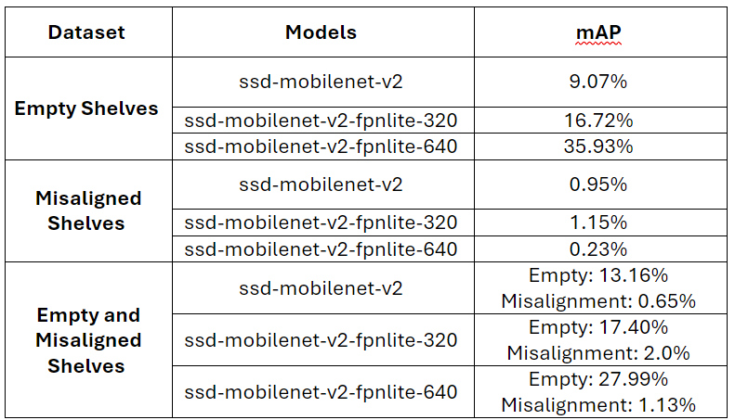
Practical Application Description
Integrates with existing inventory systems and requires robust hardware.
Scalable to different store sizes.
Benefits include increased sales, improved customer satisfaction, and operational efficiency.
Notes:
The benefits of this system include increased sales by reducing out-of-stock scenarios, improved customer satisfaction through well-organized shelves, and enhanced operational efficiency by automating shelf management tasks. Additionally, the system provides valuable data insights for better inventory management and store layout decisions. This AI vision-based system is a useful tool for modern retailers, automating critical aspects of shelf management and enhancing overall store operations.

Slide 19
Conclusion
Evaluated three AI models: SSD MobileNet V2, FPNLite-320, FPNLite-640.
SSD MobileNet V2 FPNLite-640 excelled.
Multi-class models outperformed single-class in specificity and accuracy.
Dataset | Models | mAP
Empty Shelves | ssd-mobilenet-v2-fpnlite-640 | 35.93%
Misaligned Shelves | ssd-mobilenet-v2-fpnlite-640 | 0.23%
Empty and Misaligned Shelves | ssd-mobilenet-v2-fpnlite-640 | Empty: 27.99% Misalignment: 1.13%

Slide 20
Thank You!

Slide 21
Gui Demo

